Slide 1
Fudgemart, Inc Integration
A Detailed Look Into Order Fulfillment
Tajudeen Abdulazeez, Jack O’Connor and Keith Kunz

Slide 2
Executive Summary
Problem:
Two separate subsidiaries of Fudgemart Incorporated have their down databases that contain siloed information. Fudgemart, which is a retail centric business, and Fudgeflix, a media-services provider, do not have a combined data solution for Fudgemart Inc. to understand their products, customers, vendors, or any relationships between.
Goal:
Design a BI solution based on an developed, integrated data warehouse that combines data for both Fudgemart and Fudgeflix to allow users to easily gain knowledge from data analytics.

Slide 3
Functional Requirements
Do certain customers receive orders faster than others?
Is this intentional or unintentional?
Do certain products or product categories take longer to ship?
Do certain shippers perform better than others?
Can that info be leveraged for better rates or discounts?
Do customers reorder certain products or films regularly?
If so, can we use that data for demand planning?

Slide 4
Define Order Fulfillment
How long does it take to ship a product from the order? (Lag Time)
Are orders accurate? (Not available in the data)
Are orders received on time? (Not available in the data)
How are our shippers performing? (Discussed later next slide)
Fudgeflix | Fudgemart
Queue Date (Order Date) | Order Date
Shipped Date | Shipped Date
Return Date | No Return Data
On time (<5 days order to ship) | On time (<5 days order to ship)

Slide 5
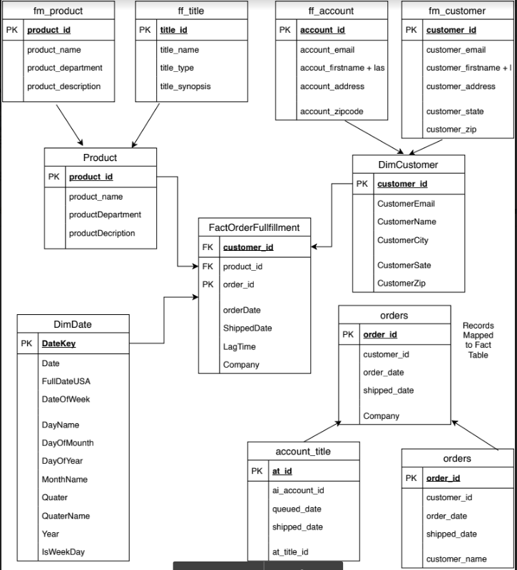
Better Together

Slide 6
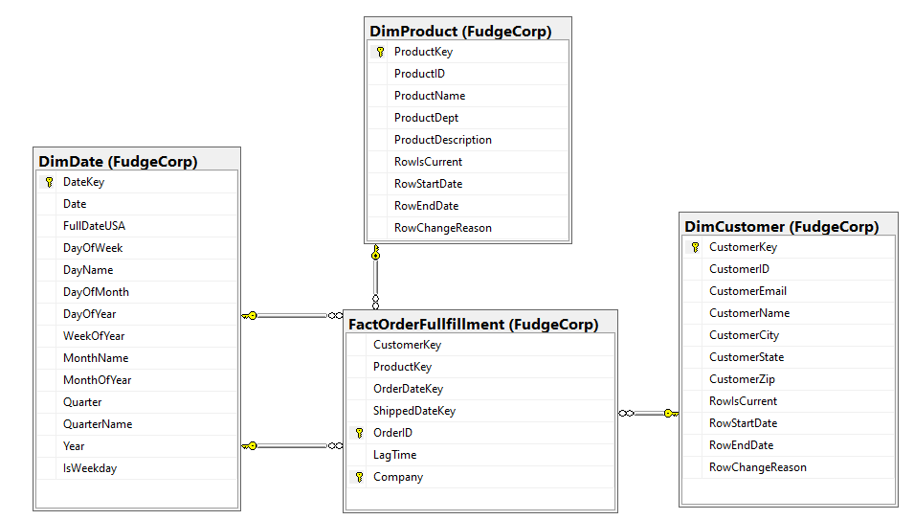
Final Star Schema

Slide 7
Shipper Debate
We decided to exclude shipper information due to the fact that neither company keeps record of delivery date to the customer nor of any freight claims.
Analysis on shippers would be great if we had data on freight claims, transit times to our customers’ cities, and freight rates between shippers. This would allow us to choose the best shippers for different locations and base the decision around price.

Slide 8
Integration Challenges
Condensing tables where possible:
Products and Titles
Customers and Accounts
Orders and Account Titles
Order Date and Queue Date
Minimizing sparsely populated tables by specifying from which company each record in the fact table came.
By using a composite key of OrderID and Company Code for the PK of the fact table, we eliminated the chance of overlapping OrderID’s from each company.

Slide 9
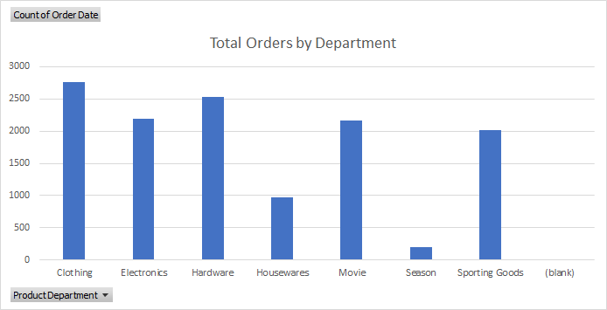
Orders by Department

Slide 10
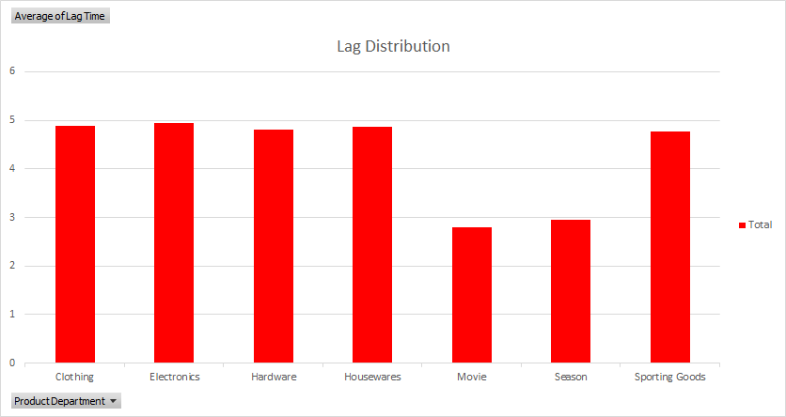
Lag Time

Slide 11
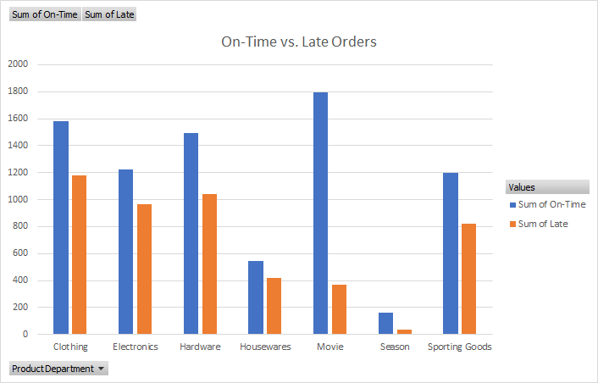
On-time and Late Orders

Slide 12
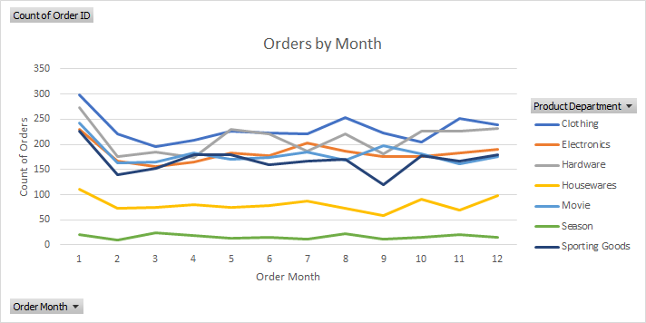
Seasonality

Slide 13
Future Data Capture
Shipment accuracy
Delivery Dates
Freight charges by shipper
Transit times to various customer locations

Slide 14
Thank you
Questions?

